Slide 1
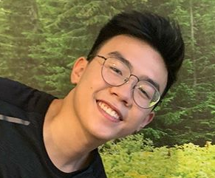
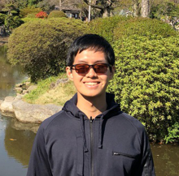
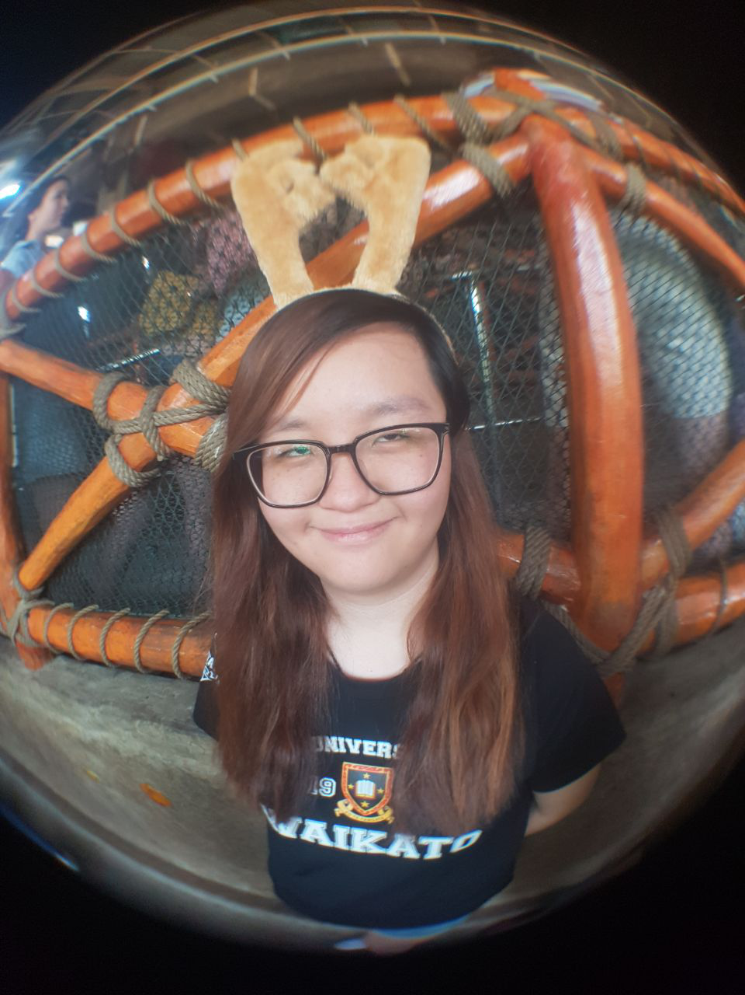
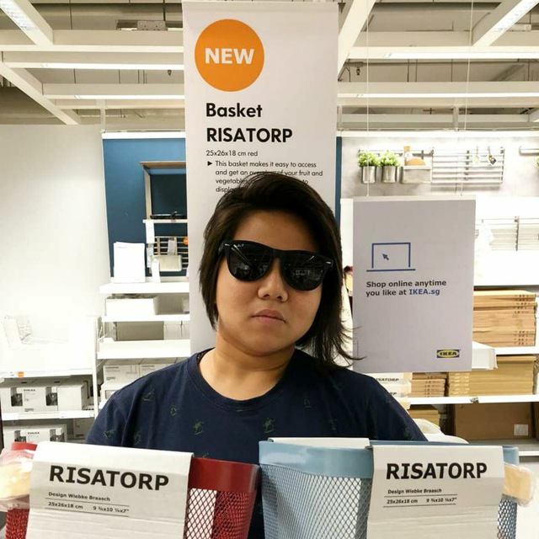
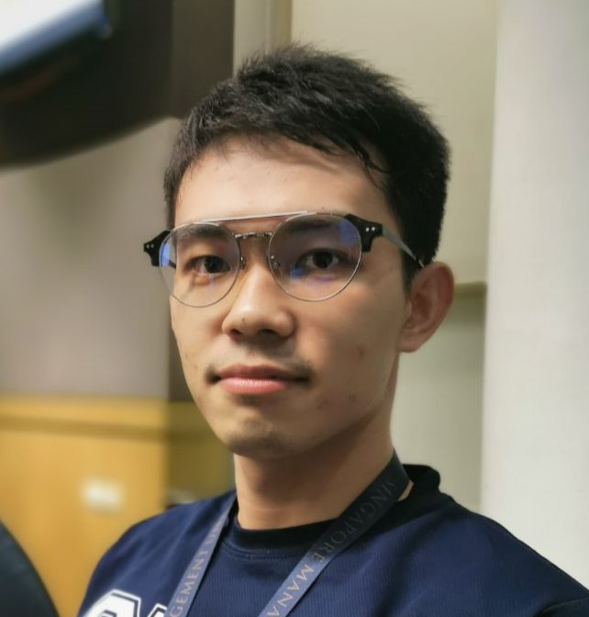
FINAL PRESENTATION
G7T1 Team SPAM
Minh
Eugene
Francine
Risa
Piao

Slide 2
Milestones
5 major milestones achieved over 9 weeks
05
04
Final Presentation
03
UAT
02
Pre – UAT
Testing
01
Application Demo
PM Review

Slide 3
Schedule Timeline (Planned)
Iter1
Iter2
Iter3
Iter4
Iter5
Week 5 – 6
Week 7 – 8
Week 9 – 10
Week 11 – 12
Week 13
Planning
phrase
JSON
UAT
Final Presentation
Functionality
Schedule planning
Database
Static webpage
Bootstrap
PM review
Bidding functions
(Update bid/ Delete bid/ Drop Section)
Improved bootstrap
Round 1 bidding and clearing logic
Application demo
JSON integration
Round 2 bidding and clearing logic
UI improvement
Pre-UAT debugging
Preparation for UAT
Prepare for UAT
Cumulated feedback from UAT session
Post-UAT debugging
Bid status
Tested and debugged all testcases
Final check before deployment
Project submission
Final Presentation

Slide 4
Schedule Timeline (Actual)
Iter1
Iter2
Iter3
Iter4
Iter5
Week 5 – 6
Week 7 – 8
Week 9 – 10
Week 11 – 12
Week 13
Planning
phrase
JSON
UAT
Final Presentation
Functionality
Schedule planning
Database
Static webpage
Bootstrap
PM review
Bidding functions
(Update bid/ Delete bid)
Improved bootstrap
Round 1 bidding and clearing logic
Application demo
Bidding functions
(Drop Section)
JSON integration
Round 2 bidding and clearing logic
Pre-UAT debugging
Preparation for UAT
Cumulated feedback from UAT session
Pre-UAT debugging
Post-UAT debugging
Bid status
Tested and debugged all testcases
Final check before deployment
Post-UAT debugging
UI improvement
Additional search functions
Integrate additional features
Final Presentation

Slide 5
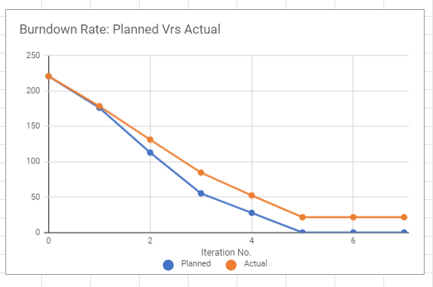
Burndown Rate
Iteration No. | Planned | Actual
0 | 220.5 | 220.5
1 | 176 | 178.33
2 | 112.75 | 131.08
3 | 55.25 | 84.58
4 | 27.75 | 52.33
5 | 0 | 21.58

Slide 6
Functionalities
01
No functionality dropped
Additional Search Filter for finding courses
02
Used Bootstrap 4 Framework for
Web UI Design
03
Finished all required functionalities for JSON and Web UI

Slide 7
Task breakdown – Iter 1
Programming Tasks
Non - Programming Tasks
Login (Minh & Risa)
Classes & DAOs
(All coders)
Bootstrapping
(All coders)
PHP revision (All members)
Schedule planning (Eugene)
Bug recordings (Eugene)
PM review preparation
(All members)

Slide 8
Task breakdown – Iter 2
Programming Tasks
Non - Programming Tasks
Deleting/Placing Bids
(Risa & Francine)
Round 1 Clearing
(Eugene & Wang Piao)
Bid results (All coders)
Debugging
(Eugene & Wang Piao)
Schedule review
(Minh)
Creating and testing
testcases (All members)
Bug recordings (Minh)
Progress update
presentation
(All members)

Slide 9
Task breakdown – Iter 3
Programming Tasks
Non - Programming Tasks
Round 2 Clearing
(All members)
JSON Dump Table
(Eugene & Risa)
JSON Update/Delete Bid
(Francine &Wang Piao)
JSON End/Start Round
(Eugene & Risa)
UI / JSON Drop Section
(Francine & Wang Piao)
Schedule review (Wang Piao)
Creating and testing manual
/ JSON testcases (All members)
Bug recordings (Wang Piao)
UAT preparation
(All members)

Slide 10
Task breakdown – Iter 4
Programming Tasks
Non - Programming Tasks
Debugging errors in
UAT testcases
(All coders)
Additional search function
(Minh & Eugene)
Web UI improvement
(Minh & Eugene)
Schedule review (Risa)
Review UAT feedback
(All members)
Bug recordings (Risa)

Slide 11
Task breakdown – Iter 5
Programming Tasks
Non - Programming Tasks
Debugging errors in
UAT testcases
(All coders)
Additional search function
(Minh & Wang Piao)
Web UI improvement
(Minh & Wang Piao)
Schedule Revision (Francine)
Bug recordings (Francine)
Testcases recording
(Eugene & Wang Piao)
Final presentation slides
(All members)

Slide 12
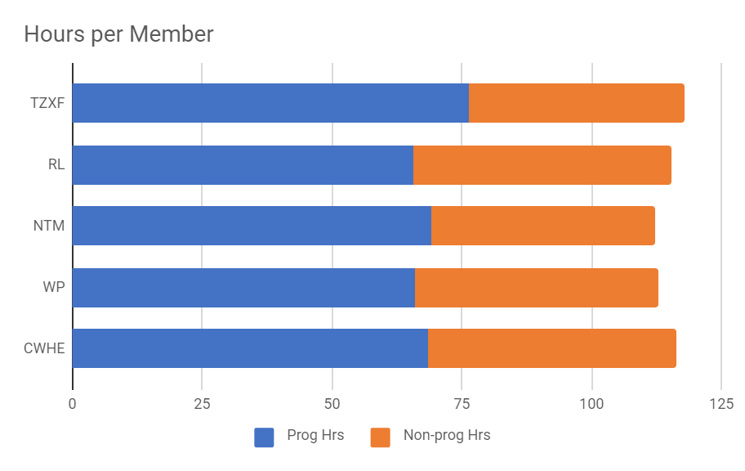
Work Breakdown (Programming Tasks)
Fair work allocation:
Reasonable work load assigned to each programming pair.
Every members’ programming hours are close to the average of 69.2hr (20% of team programming hours).
Standard deviation of 4.357.
 | Eugene | Wang Piao | Minh | Risa | Francine
Prog Hrs | 68.5 | 66 | 69.25 | 65.75 | 76.5
Non-prog Hrs | 47.67 | 46.75 | 43 | 49.5 | 41.5

Slide 13
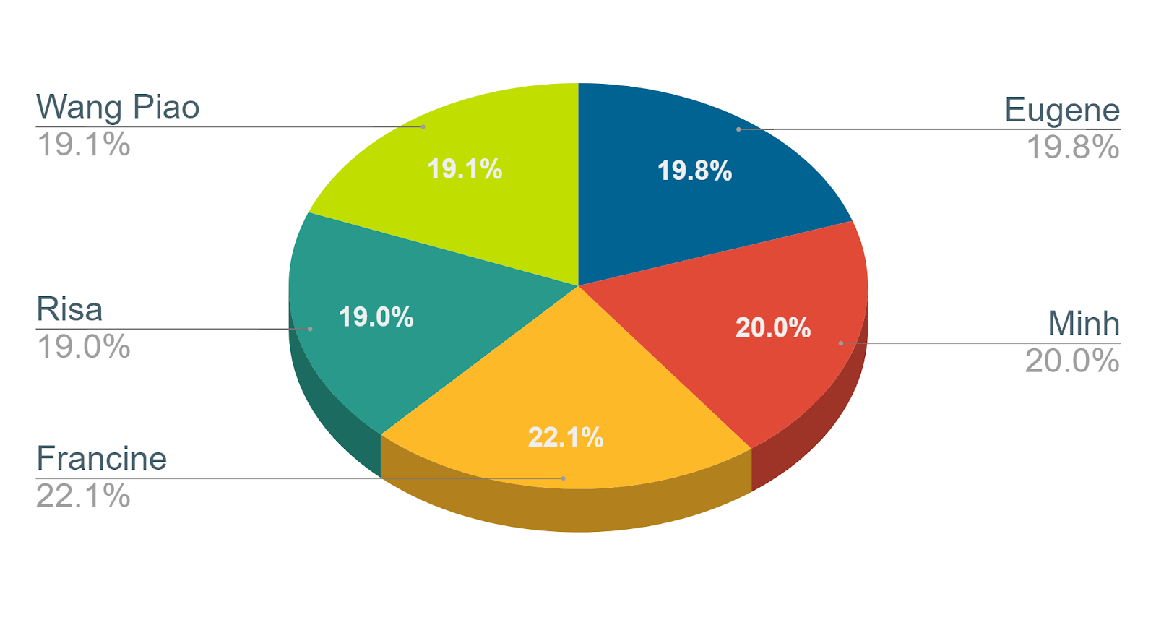
Work Breakdown (Programming Tasks)

Slide 14
Work Breakdown (Non-Programming Tasks)
 | Eugene | Wang Piao | Minh | Risa | Francine
Prog Hrs | 68.5 | 66 | 69.25 | 65.75 | 76.5
Non-prog Hrs | 47.67 | 46.75 | 43 | 49.5 | 41.5
Fair work allocation:
Reasonable work load assigned to each programming pair.
Every members’ programming hours are close to the average of 45.7hr (20% of team non- programming hours).
Standard deviation of 3.330.

Slide 15
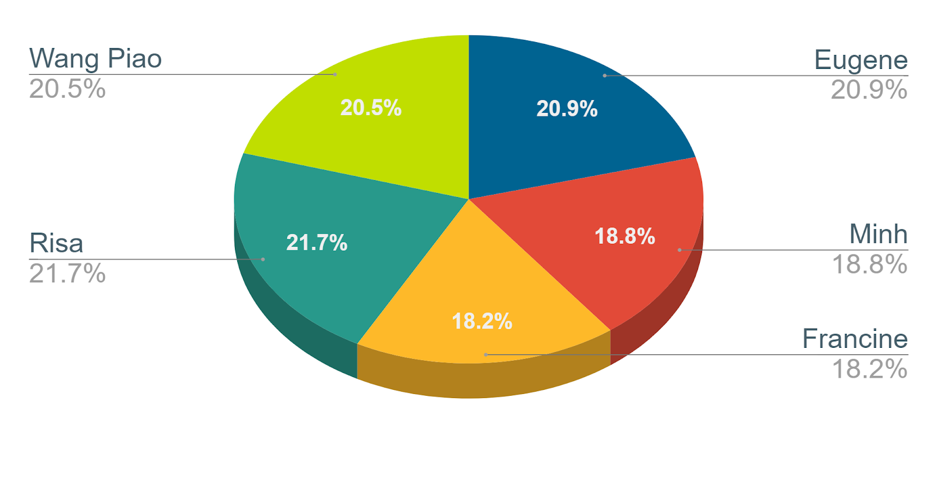
Work Breakdown (Non-Programming Tasks)

Slide 16
Problems faced
01
Estimating how much time needed to complete a task
02
How to allocate work
03
Considering the dependencies of each task

Slide 17

Solutions
Communication is key. Constantly update each other of progress via daily updates and other classes.
Share current commitments and dedicate a fixed time each week to meet.
Share programming knowledge with one another to bring them up to speed on programming.
Ensure that the prerequired tasks are planned to finish beforehand.

Slide 18
Bug Metrics
Iteration Number | Number of Bugs | Total Points
1 | 12 | 61
2 | 24 | 159
3 | 26 | 169
4 | 23 | 67
5 | 2 | 15
Total | 85 | 456
Notes:
please have a slide showing the total bug points you have found and fixed as well as the current status of the metric (the unfixed bug points) as of the time the slides were created.

Slide 19
Bug Metrics

Slide 20
Bug Metrics

Slide 21
Challenges and Solutions
Challenge:
Delay in the reporting of bugs into the bugs metric.
Solution:
PM had to constantly remind the team about reporting any discovered bugs.
No need to stop current development as bug was also fixed by discoverer when reported.
Notes:
Occasionally when a bug is discovered, our coders are motivated to solve the current issue at hand. This causes a delay in the recording of the bug in the metric. Being obsessed with the task at hand, we lose sight of the bigger picture and jeopardize the project.

Slide 22
Major Follow-on Actions
15/24 for Web UI UAT → Stop current development
Rearrange the bugs according to severity from highest to lowest.
Assign all bugs with highest severity to be tested and solved them in a programming groups of two.
Followed by solving bugs with lower severity.
Notes:
We thought we were done with all functionalities

Slide 23

Use of Git

Slide 24
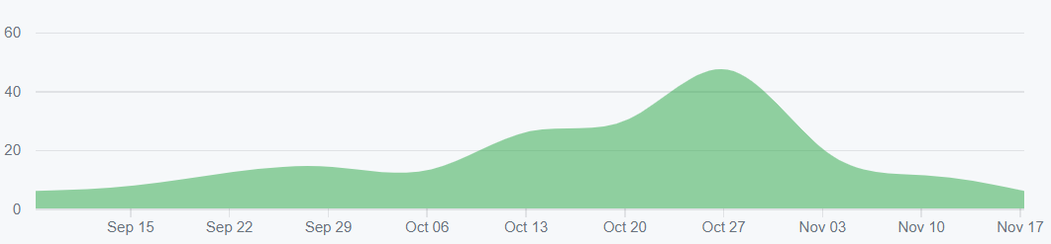
Contribution timeline
Consistent daily commits

Slide 25
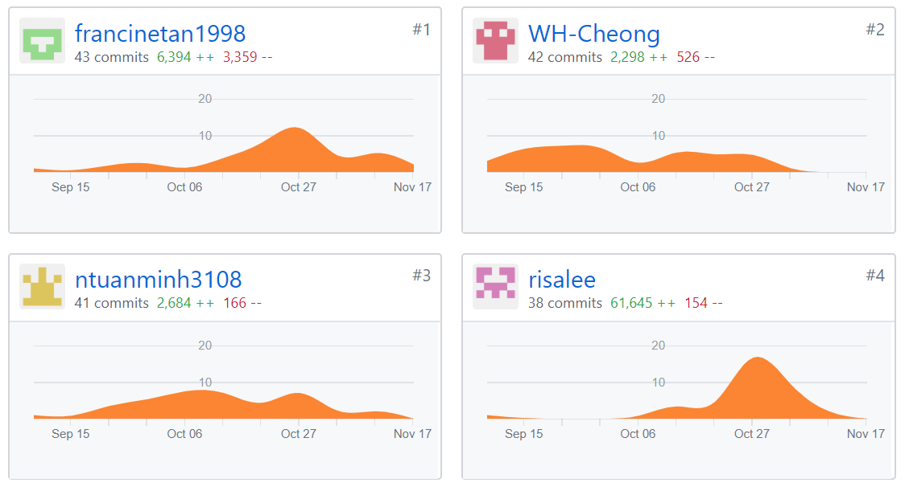
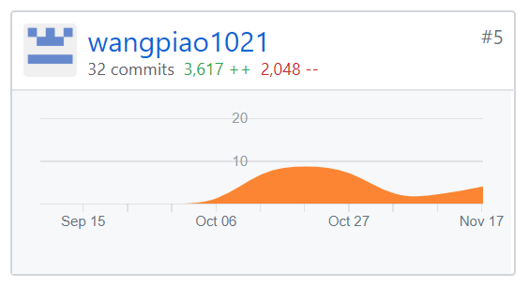
Individual Contribution
Mostly even commits
& average of 39
commits per member

Slide 26
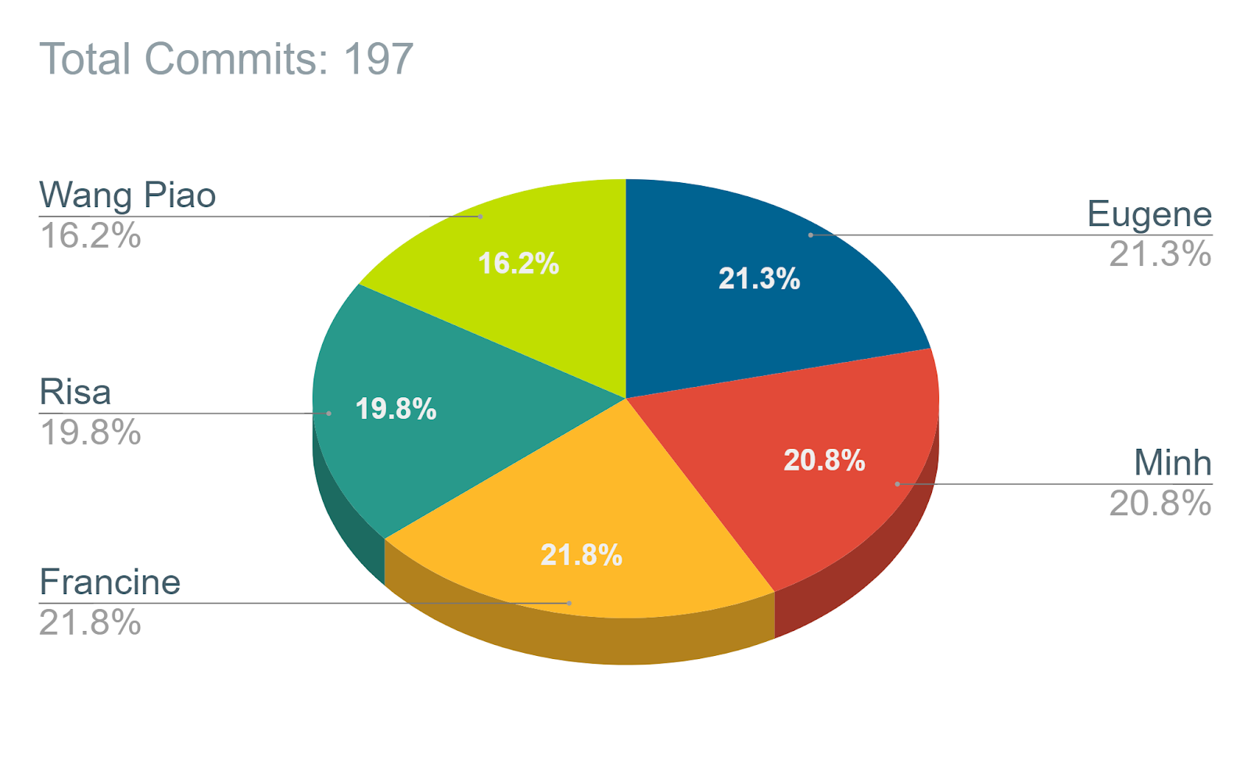
Individual Contribution Breakdown

Slide 27
Handling a software project a big step from what we have learnt last year - integration, and regression testing over multiple iterations required.
Challenges team to work with each other (prior programming done individually).
Importance of proper software management skills (not just in future modules, but also when working in teams in the workplace).
Practice makes perfect!
Main Takeaways From Project
Notes:
Handling a software project a big step from what we have learnt last year (small programs and assignments/lab tests cannot compare) due to including elements such as integration, and regression testing over multiple iterations.
Not only that, it challenges groups to work with each other (prior programming work is mostly done individually).
However, we also understand how important it is to have proper software management skills in future (not just in future modules, but also when working in teams in the workplace).
Practice makes perfect! Take the time in the future to continue strengthening Project Management Skills so that work can be done without delays or stakeholder disappointments.

Slide 28
Team Issues
We did not “click” until a few weeks after we first met (Week3).
Although some of us knew each other from other modules, we were not close.
However, over time, we found common interests and subjects that interests us (like food) and that brought us closer together as a team.

Slide 29
Interesting Points About Team Members
Minh | Initially claimed that Barney is a blue dinosaur.
Risa | Parents are also currently studying at SMU too (under SkillsFuture)!
Eugene | Knows how to cook Taiwanese dishes such as braised pork rice.
Wang Piao | Has a treasure vault full of cold jokes. Because of this, we created a new nickname for him: “Air conditioner”.
Francine | Full of interesting quotes such as “How now, brown cow?”.

Slide 30


